Slide 1

Angular Js
HTML enhanced forWeb Apps

Slide 2
whoami
Abhinav Gujjar
12+ years of experience
Microsoft, Thomson Reuters
Startup, Consultant, Trainer

Slide 3
Guidelines
Phones on Silent
Concepts, not Syntax
Questions…. Lots !

Slide 4
Pre-requisites
Javascript knowledge
Editor
Chrome preferably
Git (SourceTree)

Slide 5
Agenda
Context
Evolution of Web Frameworks
Why Angular?
Angular Components
Controllers, Services, Filters, Routing & Views, Binding
Advanced Angular
Custom Directives, Communication, Scopes, $http, Best Practices
Unit Testing
Bootstrap 3

Slide 6
Context

Slide 7
Web Sites vs Web Applications
Sites
Apps
Wikipedia
cnn.com
Google Drive
JIRA
Balsamiq
…
Rediff.com
…

Slide 8
Why Web Frameworks?
Internet was built for resources not apps
http / URL / HTML

Slide 9
Evolution of Web Frameworks
Server
PHP / ASP
ASP.Net Web Forms
ASP.Net MVC, Spring MVC
Client
Silverlight
Angular

Slide 10
Angular Fundamentals

Slide 11
Philosophy
Opinionated
Comprehensive
Open Source

Slide 12
Opinionated
Very clear idea about *HOW* a Web application should be structured

Slide 13
Comprehensive
Data-binding
Templating
Form validation
Routing
Reusable components
Dependency Injection

Slide 14
Open Source
Good open source

Slide 15

Demo – Hello World

Slide 16

Basic Application
Include angular.js in the page
Add ng-app Directive
Angular Directive
ng = Angular
Notes:
ng-App is a Gotcha
Ng-App starts the compilation process
Angular js must be included

Slide 17
Templates
Regular HTML with some extra markup
Compiled to produce the “View”

Slide 18
View
Rendered DOM

Slide 19
Directives
New type of markup
Add behavior to attribute or element of HTML
ONLY understood by angular compilation process
Can create custom directives

Slide 20
Expressions
Javascript like code snippets
Read and write variables
Forgiving
No Control flow
Notes:
{{ 10 * 3 }}
{{ 'hello ' + 'world }}
{{ [1,2,3][2] }}
{{ Math.min(2,3) }}

Slide 21
Data Binding
Synchronization of model data with the view
1 –way AND 2- way

Slide 22
Controllers
UI related logic
Prepare the model for the view
Attach it to the scope

Slide 23
Directives Usage
Attribute -<div ng-form/>
Element - <ng-form></ng-form>
Class - <div class=“ng-form”>
Comment

Slide 24
Directives
ngApp
ngController
ngCloak
ngNonBindable

Slide 25
Directives
ngBind
ngBindHtml
ngBindTemplate
ngHide
ngShow
ngIf
ngSwitch
ngClass
ngStyle
ngClassEven
ngClassOdd

Slide 26
Directives
ngDisabled
ngChecked
ngReadonly
ngSelected
ngForm
ngSubmit
ngHref
ngSrc
ngNonBindable

Slide 27
Other Directives
ngApp
ngBind
ngBindTemplate
ngBindHtml
ngHide
ngShow
ngCloak
ngModel
ngStyle
ngClass
ngClassEven
ngClassOdd
ngDisabled
ngChecked
ngMultiple
ngReadonly
ngSelected
ngForm
ngSubmit
ngHref
ngSrc
ngNonBindable

Slide 28
Directives - Events
ngClick
ngDblClick
ngMousedown
ngMouseenter
ngMouseleave
ngMousemove
ngMouseover
ngMouseup
ngChange

Slide 29
GOTCHA!
ngClassEven in HTML = ng-class-even
Notes:
Since HTML is case insensitive, we use dash-delimited

Slide 30
Modules
Containers

Slide 31
Enough Snippets!
Real World (ish) application
Angular Seed
Bower
Bootstrap
Notes:
Since HTML is case insensitive, we use dash-delimited

Slide 32
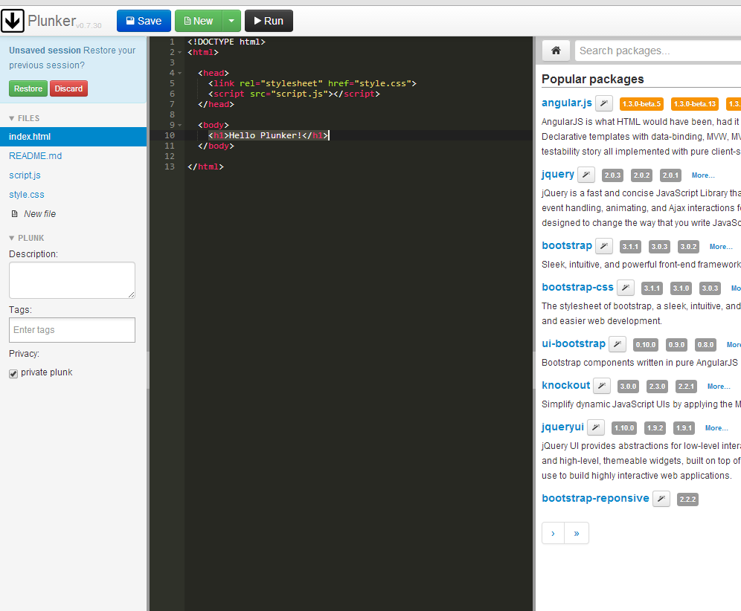

plnkr.co

Slide 33
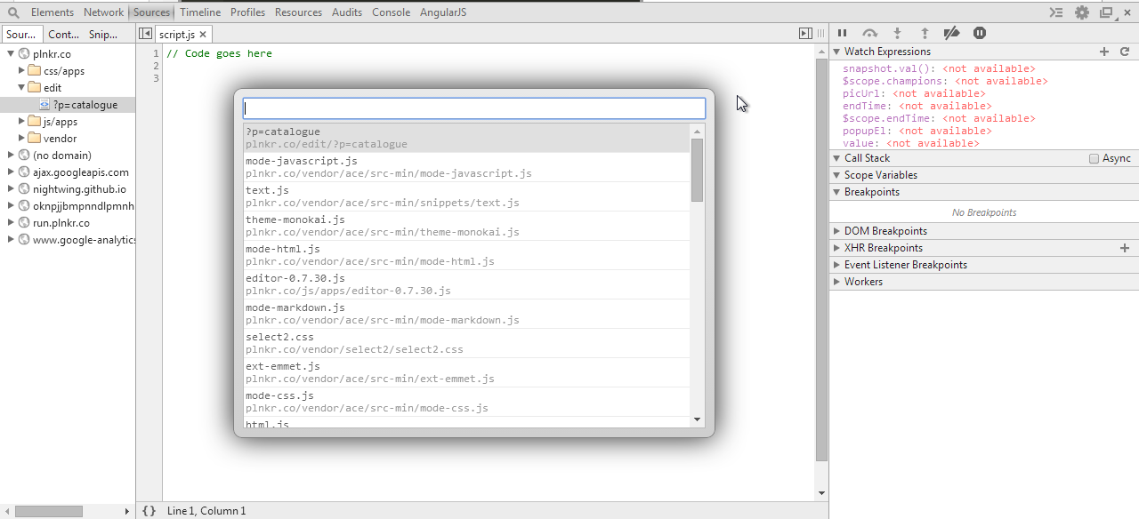
Developer Tools

Slide 34
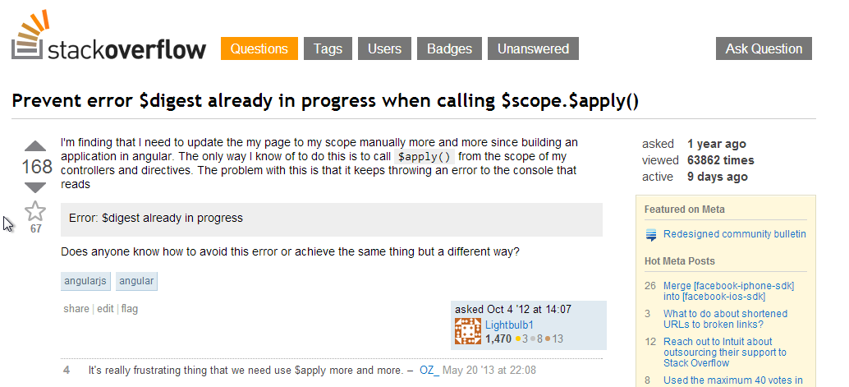
StackOverflow

Slide 35
Angular - MV*
Model
Controller
View
Server

Slide 36
Components
Services
Controllers
Views / Directives

Slide 37
Filters
Modifying output
Formatting output
Sorting
Filtering
{{ expression | filter }}

Slide 38
Built in Filters
uppercase
lowercase
number
currency
date
json
orderBy
limitTo
filter

Slide 39
Two-way Binding - ngModel
Input
Select
Textarea

Slide 40
Functions
forEach
isUndefined
isObject
toJson
equals
copy
angular.forEach(values, function(value, key){
//dosomething
});

Slide 41
Validation
Required
ngPattern
Form properties
CSS classes

Slide 42
Services
Not Web Services
Some worker object really
Typically stateless

Slide 43
Why Service
Single Responsibility principle
Reusable
Dependency Injection
Testable

Slide 44
What is it?
Registration required
Can be then injected

Slide 45
Built in Services
Navigation
Location
http
q

Slide 46
Custom Service
Value
Factory

Slide 47
Routing
Single Page Application
$route service
$location service
Browser history

Slide 48
$location service
When you need to REACT to a change in the URL
When you need to MAKE a change to the URL

Slide 49
$route service
Access information about a route
current
routes
Reload !

Slide 50
Template and Resolve
Template
Custom inline HTML
Resolve

Slide 51
Browser History
Automatically managed by AngularJs

Slide 52
Accessing route parameters
$routeParams

Slide 53
Custom Directives
Dynamic HTML
Separating markup from logic
Isolate scope

Slide 54
Uses
Custom Elements
Custom Events
Observe and react to changes

Slide 55
Communicating
Inherited Scopes
Events
Shared Service

Slide 56
Unit Testing

Slide 57
Single Page Applications

Slide 58
Best Practices
Directory Structure- Angular-seed
Script tags at the bottom – loading is blocking

